Slide 1
Introduction to Computers for Engineers: Recitation #2

Slide 2
Learning Objectives
Learn how to write functions in MATLAB
Understand that functions are templates that can be modified and reused to suit your needs
Understand that functions are used by calling them
Understand that you are finished writing a function after you have tested it
Understand that functions can be used together within other programs to perform larger tasks

Slide 3
Activity 1: Function warm-up
Write a function with 2 inputs and 2 outputs named math
Remember that the name of the function and the filename must both be math
Inputs:
num1: Double
num2: Double
Outputs:
difference: num1-num2
sum: num1+num2
Run your function to make sure it works!
Questions:
How do you call a function?
Are there any similarities between the function call and the function header?
What does it mean to have an input? Assign an output value? Do we need to print anything or ask the user for anything?

Slide 4
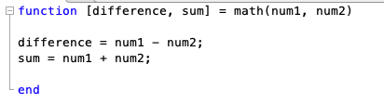
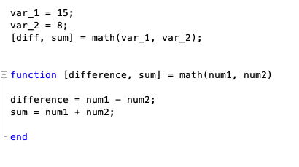
Activity 1: Solutions
Question: What if you wanted to run the function inside the script?
Remember: now the script has to have a different name than the function!

Slide 5
Activity 2: More functions
Write a function with 2 inputs and 2 outputs named math2
Inputs:
num1: Double
num2: Double
The outputs can be any mathematical operation you want, example:
recitation_sucks: (num_1 + num_2) * (num_1^2)
im_lost: (num_1*num_2) + (num_1 / num_2)
In your group:
Create test cases (i.e. run it with different inputs to make sure that it works)
Discuss: What do you think an appropriate number of test cases is for a program like this?
Discuss: Why might functions be useful to write instead of plain scripts?

Slide 6
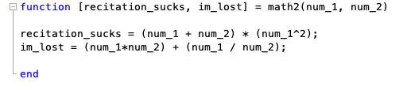
Activity 2: Solutions

Slide 7
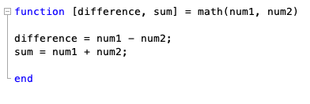
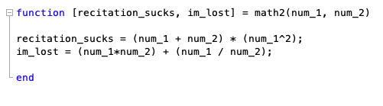
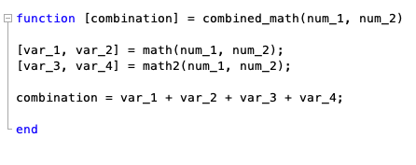
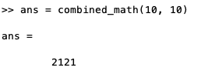
Activity 3: Calling multiple functions (Example)
Suppose I wanted to add all of the results from the function math and math2
This works as long as all of the MATLAB functions are located in the same directory!

Slide 8
Activity 3: Calling multiple functions
We are going to create a GPA calculator!
Let’s first create the function totalCredits():
total_creds = totalCredits(credit_array)
The purpose of function totalCredits() is to compute the total number of credits you’ve taken. You can use the built-in MATLAB function sum().
Example:
credit_array = [3, 4, 3, 1]
total_creds = sum(credit_array)
Make sure that your function works!
Note:
A = 4.0
B+ = 3.5
B = 3.0
C+ = 2.5
C = 2.0
D = 1.0

Slide 9
Activity 3: Calling multiple functions
We are going to create a GPA calculator!
Now create the function totalPoints():
total_points = totalPoints(credit_array, grade_array)
NOTE: credit_array and grade_array should align.
Example:
credit_array = [3, 4, 3, 1]
grade_array = [4.0, 3.5, 2.5, 0.0]
individual_points = credit_array .* grade_array
total_points = sum(individual_points)
NOTE: .* denotes element-wise multiplication of arrays!
Make sure that your function works!
Note:
A = 4.0
B+ = 3.5
B = 3.0
C+ = 2.5
C = 2.0
D = 1.0

Slide 10
Activity 3: Calling multiple functions
Note:
A = 4.0
B+ = 3.5
B = 3.0
C+ = 2.5
C = 2.0
D = 1.0
We are going to create a GPA calculator!
Now create the function computeGPA():
gpa = computeGPA(credit_array, grade_array)
NOTE: credit_array and grade_array should align.
This function should output the result of dividing the output of totalPoints() by the output of totalCredits()
gpa = totalPoints() / totalCredits()
Make sure that your function works!
Question: Why do you think creating a function to compute the GPA is better than just writing a script?

Slide 11
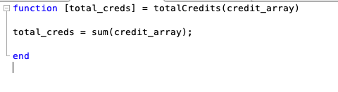
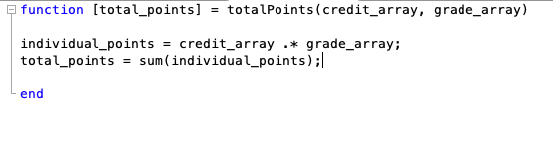
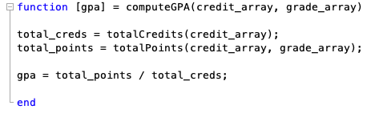
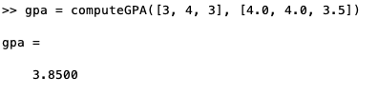
Activity 3: Solution

Slide 12
Activity 3: More on functions
How would you modify the computeGPA() function so that it can compute your GPA for two semesters?
Hint: Increase your number of input arrays to 4 and re-use your functions!

Slide 13
Activity 4: Make your own sequence of functions!
Think of your own example where you think leveraging multiple functions would be useful.
Discuss with your group and implement it together!

